Slide 1
Configuration Drift Detector
Team 04 | UC ID: IM-04 | Infra Maintenance Category
Infinite Computer Solutions Placement Drive
GitHub: https://github.com/saicharan-122/Config-Drift-Detector
Live: https://config-drift-detector.onrender.com

Slide 2
Meet the Developer Team
STUDENT NAME | ROLL NUMBER | BRANCH / SPECIALIZATION
Pappala Devi Sai Charan | 23U41A0542 | CSE
Pentakota Tanuja | 23U41A0545 | CSE
Bevara Lize | 23U41A4405 | CSD
Peela Divya Santhoshi Lakshmi | 24U45A0423 | ECE

Slide 3

Introduction & Overview
This project introduces an AI-Powered Configuration Drift Detector.
It automatically identifies differences between intended and actual system configurations.
Provides deep insights, generates detailed reports, and calculates risk scores to help maintain infrastructure integrity.

Slide 4
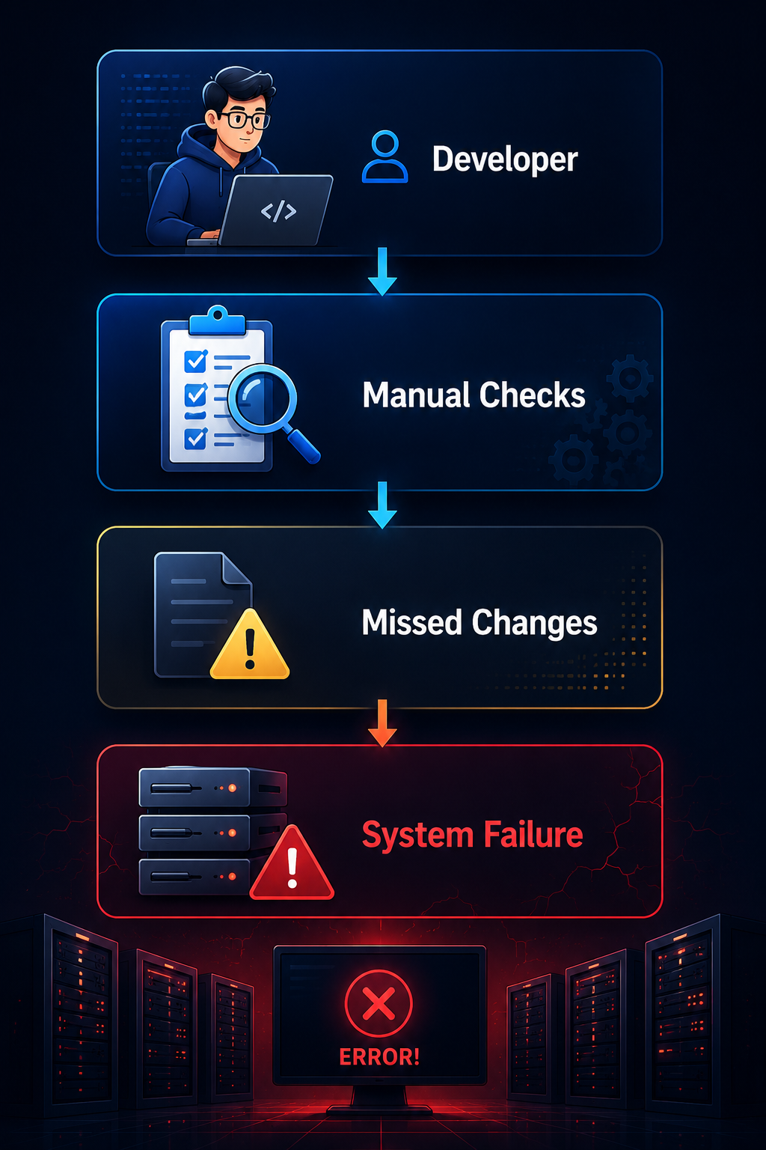
Problem Statement
Manual configuration management is error-prone and time-consuming.
Undetected configuration drifts can lead to security vulnerabilities, compliance issues, and system outages.
There is a need for an automated solution that not only detects changes but also assesses their impact and provides actionable insights.

Slide 5
Proposed Solution
An intelligent web-based platform comparing 'intended' and 'actual' configurations.
Utilizes backend file processing to accurately pinpoint file-level and content-level discrepancies.
Integrates with Google Gemini API to analyze detected drifts and explain potential impact.
Automatically calculates a Risk Score to prioritize remediation efforts.

Slide 6
Key Features
Configuration Drift Detection: Accurate file and content comparison.
Risk Assessment: Automated calculation of risk scores based on drift severity.
Dashboard Analytics: Visual representation of infrastructure health.
Exportable Reports: Generate comprehensive reports in PDF and Markdown formats.
History Tracking: Maintain a log of past scans and configuration states.
AI Integration: Advanced analysis powered by Google Gemini API.

Slide 7
How It Works (Workflow)
Step 1: Upload Configurations
User uploads 'Intended' and 'Actual' directories via the web portal.
Step 2: File Comparison
Backend scans both directories and flags missing, extra, or modified files.
Step 3: AI Analysis
Gemini API evaluates differences to assess the severity of drifts.
Step 4: Dashboard & Reporting
Results are displayed on a dynamic dashboard and exported as PDF/Markdown.

Slide 8
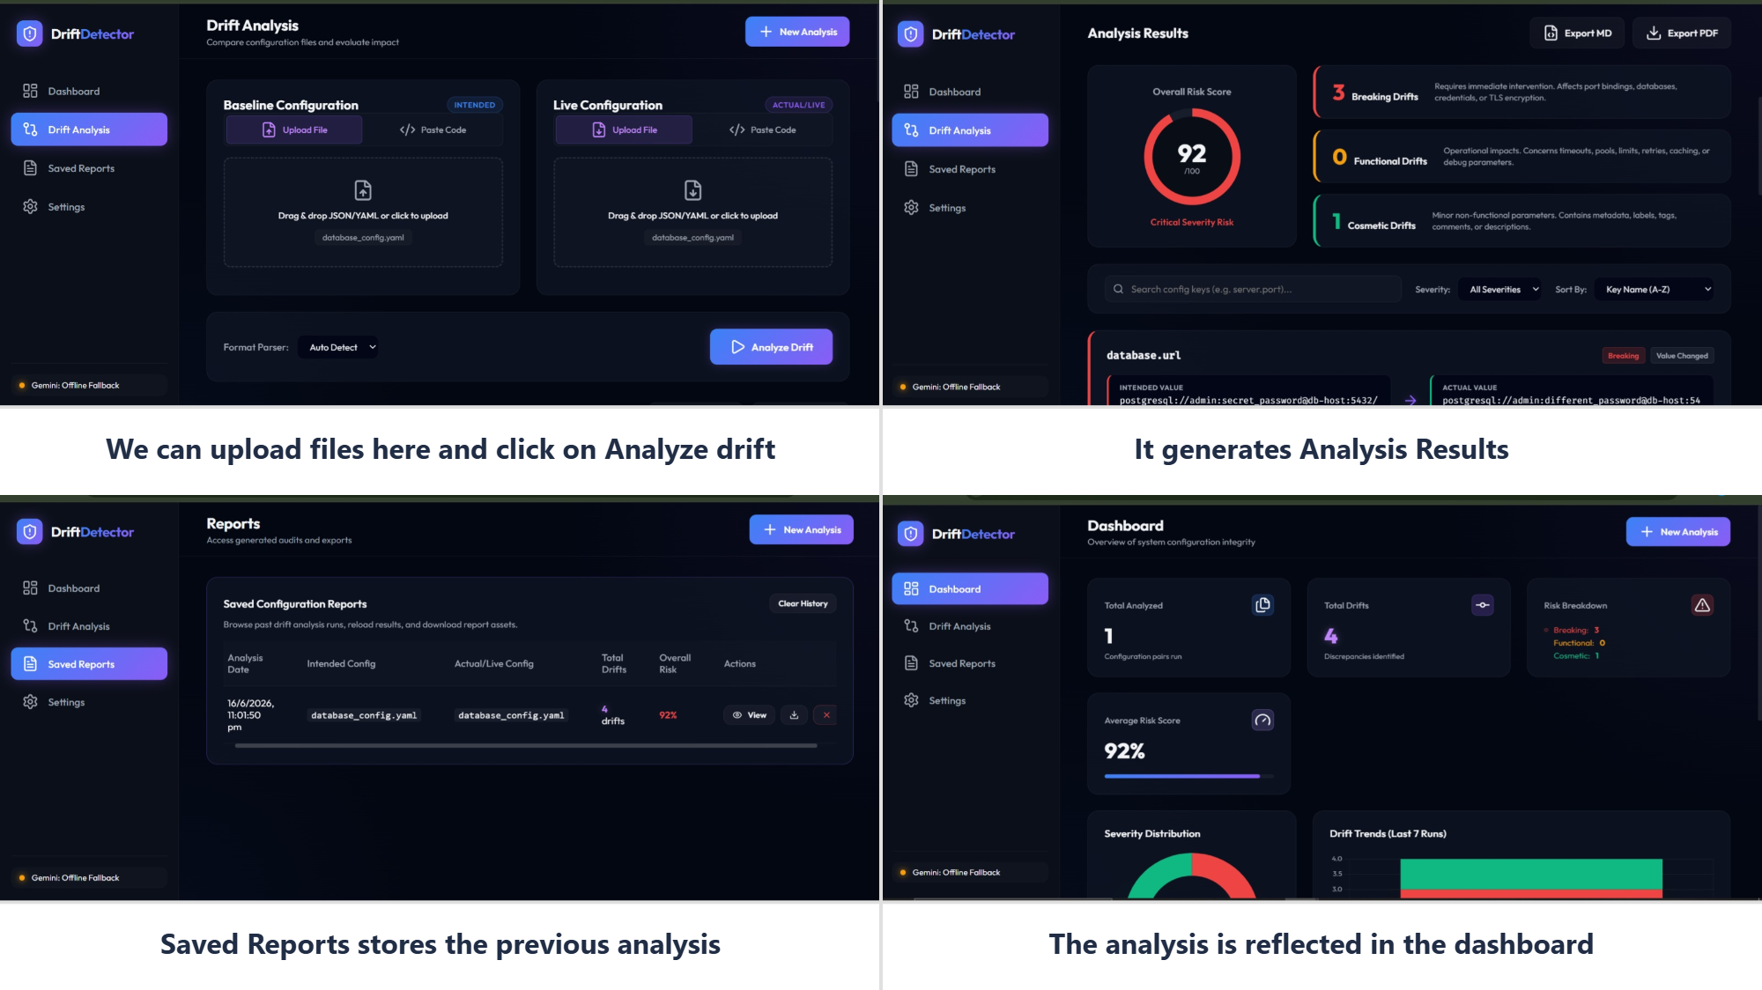
Process Representation

Slide 9
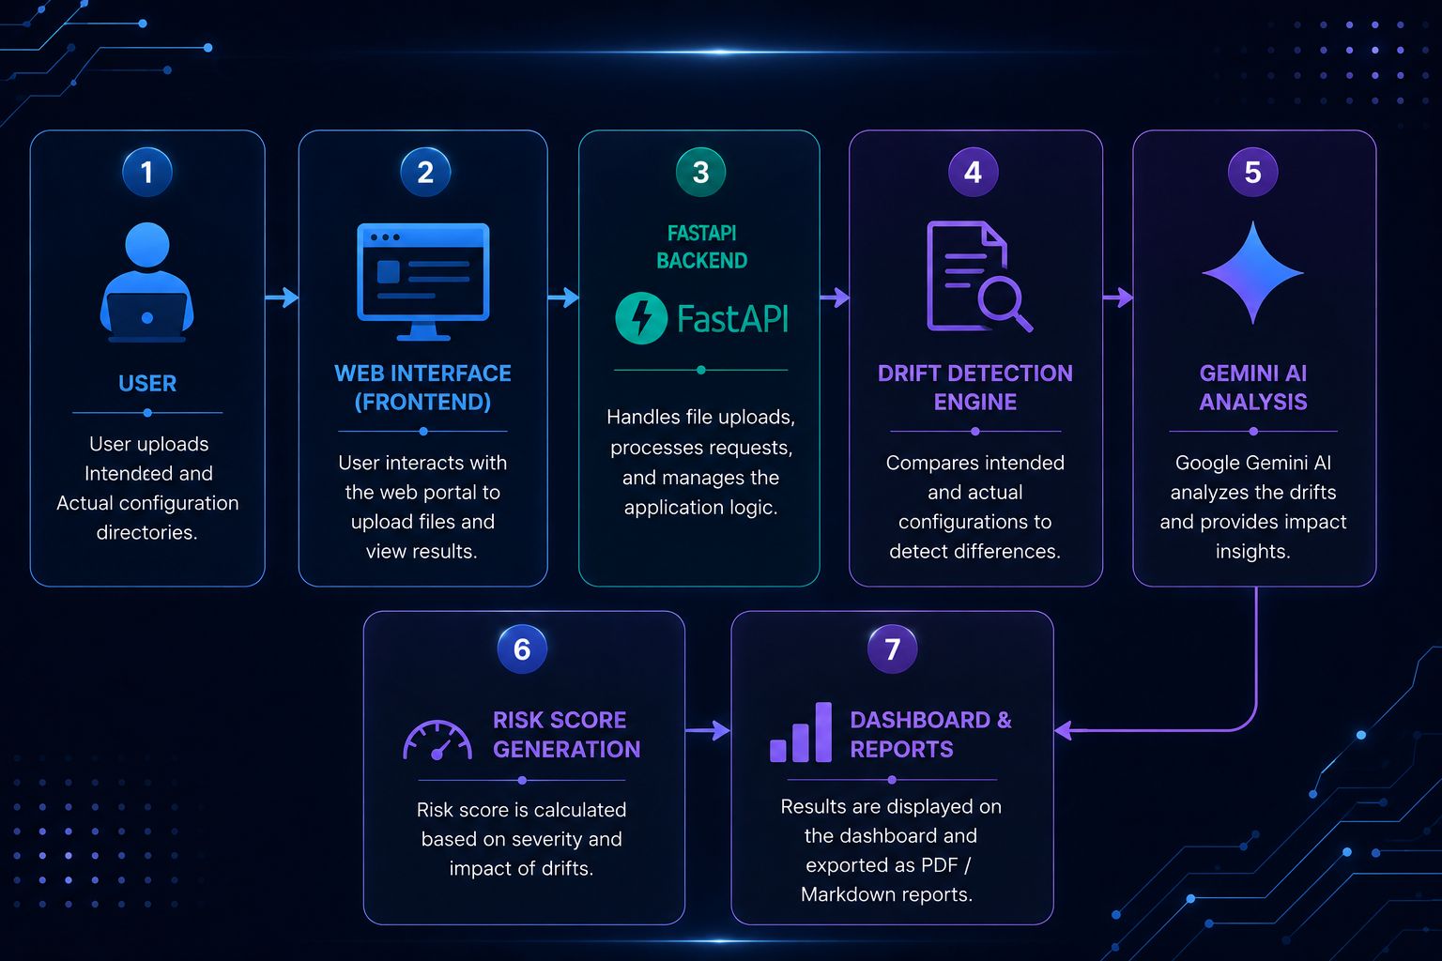
System Architecture
User
↓
Drift Detection Engine
↓
Gemini AI
↓
Risk Score + Reports

Slide 10
AI Integration (Google Gemini API)
The system leverages the Google Gemini API to add an intelligent layer to traditional drift detection.
It analyzes the context of the configuration changes, rather than doing a naive diff.
Gemini generates human-readable explanations of what the drift means for system security and stability.
This reduces the cognitive load on system administrators and speeds up incident response.

Slide 11
Risk Scoring Methodology
Base Calculation:
Each drift is assigned a base severity (Low, Medium, High, Critical) by the AI.
Impact Assessment:
The system analyzes whether the change impacts security, performance, or availability.
Final Risk Score:
A numerical score (0-100) is generated. Scores > 80 trigger high-priority alerts.
Prioritization:
Enables teams to tackle critical misconfigurations before minor cosmetic changes.

Slide 12
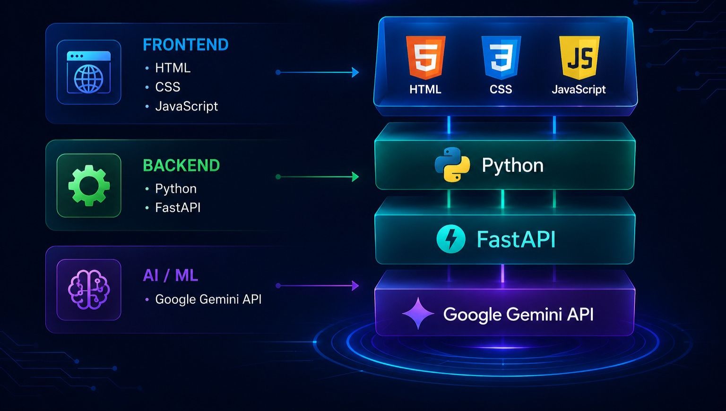
Technology Stack
Frontend:
HTML
CSS
JavaScript
Backend:
Python
FastAPI
AI / ML:
Google Gemini API

Slide 13
Project Structure
The application is organized into distinct directories for clarity and separation of concerns:
/intended: Stores the baseline, approved configuration files.
/actual: Stores the current, live configuration files.
/backend: Contains the FastAPI application, routing, and logic.
/frontend: Contains the UI assets (HTML, CSS, JS).
This modular structure ensures easy maintenance and scalability.

Slide 14
Value Proposition & Benefits
Operational Efficiency:
Reduces manual review time by automating file-by-file comparisons.
Enhanced Security:
Detects unauthorized configuration changes before they lead to breaches.
Cost Reduction:
Minimizes system downtime through faster incident resolution.
Compliance Readiness:
Maintains detailed audit logs and reports for regulatory requirements.

Slide 15
Future Enhancements
Real-time monitoring agents to detect drifts instantly without manual uploads.
Integration with popular CI/CD pipelines (e.g., GitHub Actions, Jenkins).
Auto-remediation capabilities to automatically revert unauthorized changes.
Support for cloud provider configurations (AWS, Azure, GCP) via APIs.
Advanced access control and role-based permissions for enterprise use.

Slide 16
Conclusion
The AI-Powered Configuration Drift Detector provides a modern, intelligent approach to infrastructure maintenance.
By combining traditional file comparison with Google Gemini's AI capabilities, it offers unparalleled context and risk assessment.
It significantly reduces downtime and enhances the security posture of IT environments.
Thank You!

